Slide 1

SAP POINT CALCULATION
SUBMITTED BY:
JOTHI SREE R S DHARSHANA V
ANJUM I

Slide 2
ABSTRACT
This project revolves around the development of a student activity point calculation system in a college environment using Python and database connectivity. The system employs Python programming to create a user-friendly interface for tracking and managing student activities. Through seamless integration with a database, the application efficiently stores and retrieves relevant information, ensuring accuracy and reliability in calculating student activity points. The implementation aims to streamline the process of tracking and rewarding student involvement in various activities, fostering a transparent and efficient method for evaluating and recognizing their contributions within the college community.

Slide 3
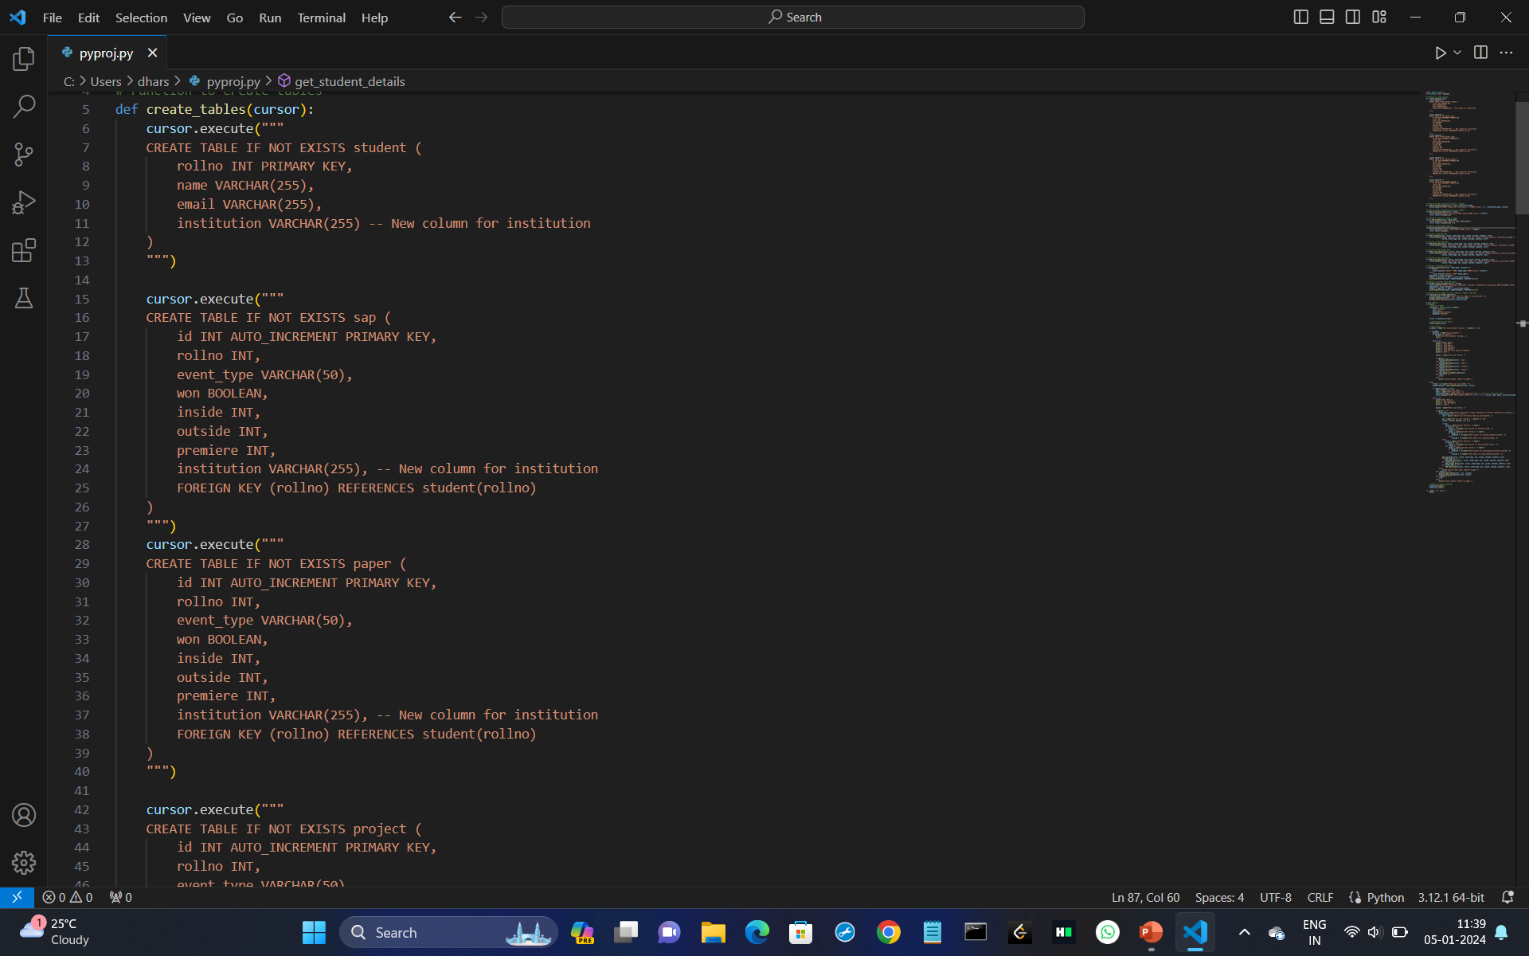
Student
SAP
Paper
Project
Coding
TABLES

Slide 4

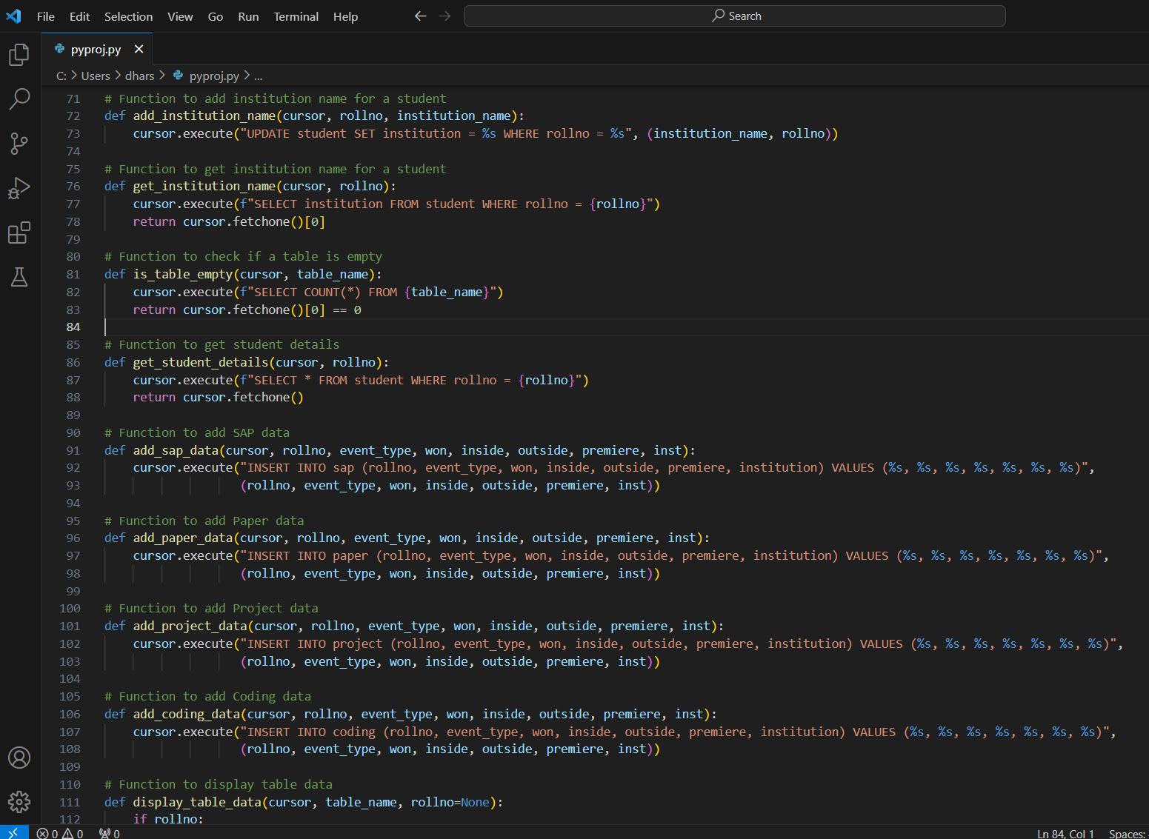
CODE OVERVIEW
Establishes a connection to a MySQL database using `mysql.connector`.
Defines tables for student achievements, such as SAP, Paper, Project, and Coding.
Differentiates between administrators and students based on user input.
Provides administrators with options to view and manage achievements data, requiring a password for access.
Allows students to input details about SAP participation, including event type, winning status, and points.
Incorporates separate functions for adding SAP, Paper, Project, and Coding data to their respective tables.
Utilizes the `tabulate` library to display table data in a structured format.
Enables the display of total SAP points for a specific student based on their roll number.

Slide 5
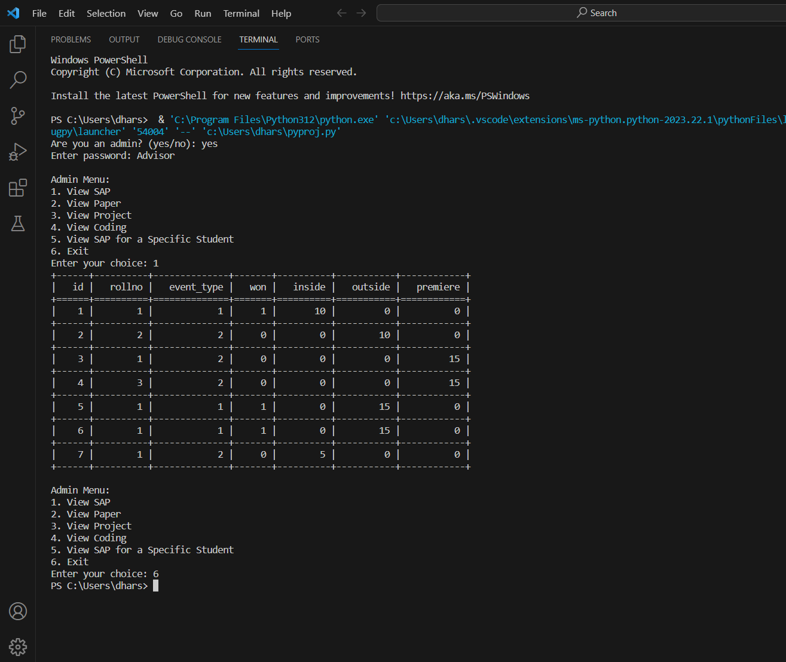
OUTPUT
View sap

Slide 6
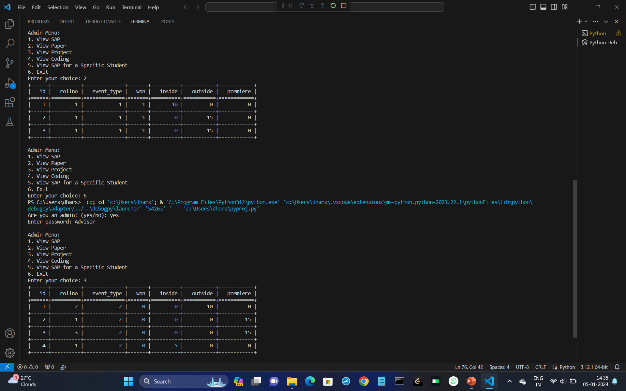
VIEW PAPER
VIEW PROJECT

Slide 7
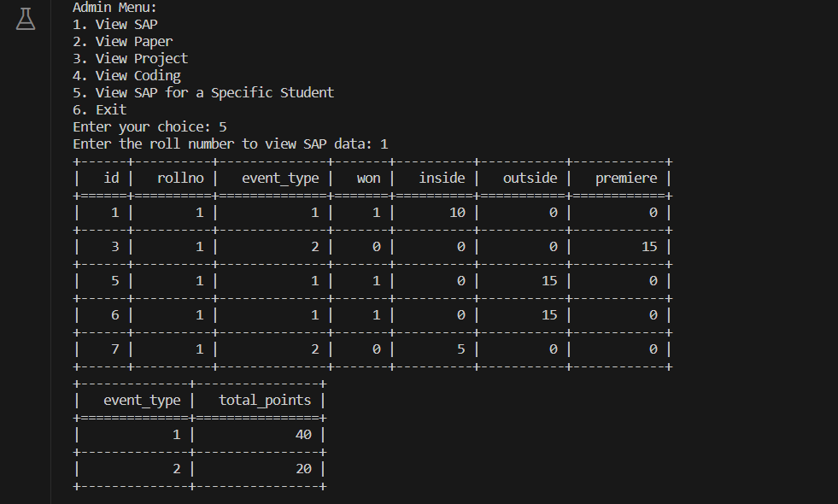

VIEW SAP FOR A SPECIFIC STUDENT

Slide 8
THANK YOU

